Slide 1
In Vitro Fertilization
Institution affiliation
Name of lecturer
Name of student
Submission Date

Slide 2
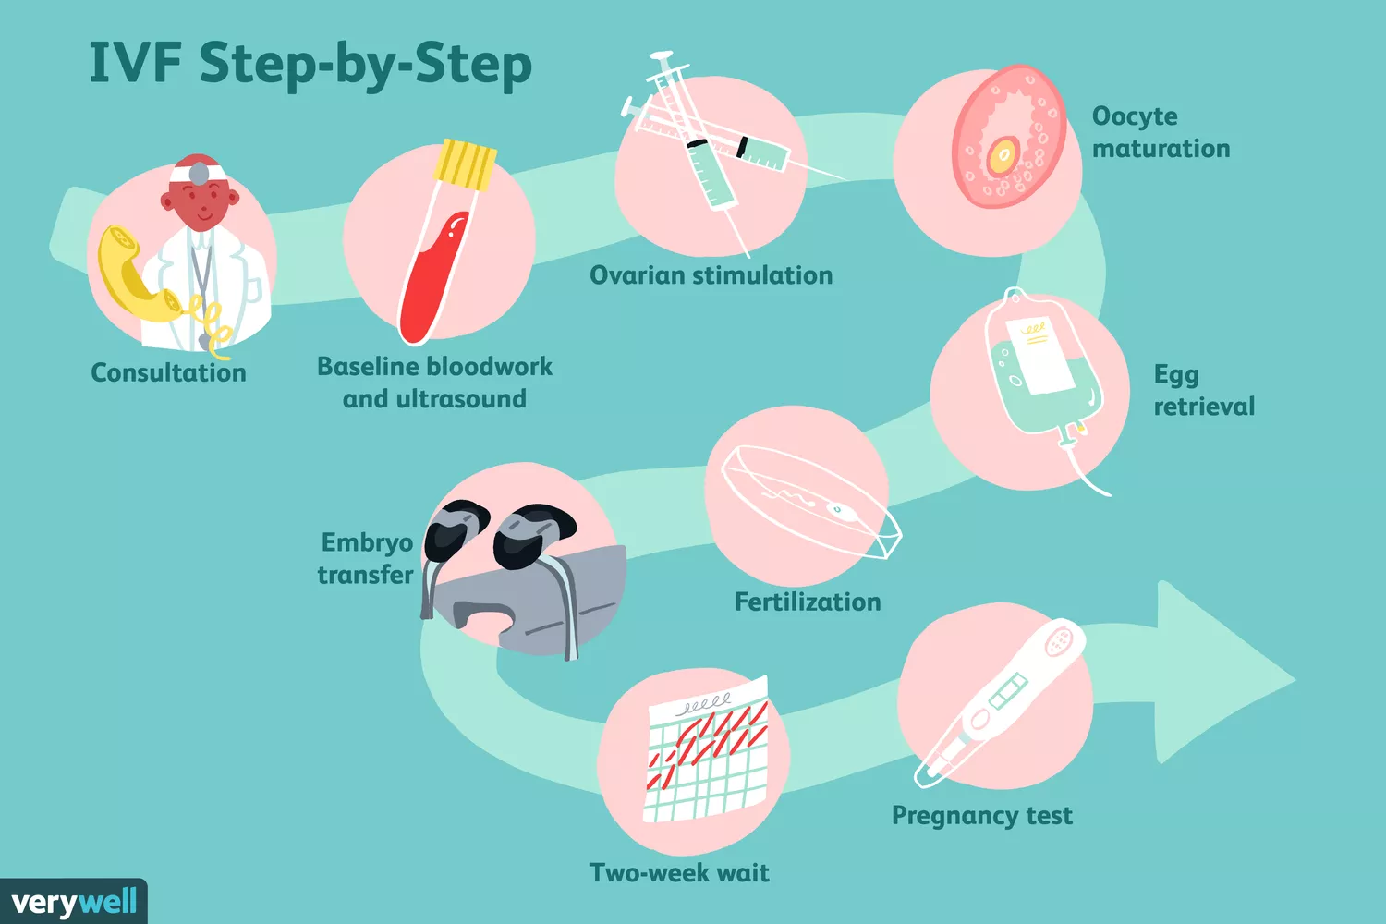
Introduction
IVF is a complex series of methods that are used to help in fertility problems, child conception and prevent genetic problems.
In IVF, mature eggs are retrieved from the ovaries and then they are fertilized by a sperm in a lab.
The embryo is then transferred to the uterus .One full cycle might take a period of three weeks but in other cases the steps can be split into different parts which may lengthen the process.
It can be also done if one has certain health problems for example fallopian tube damage, ovulation disorder, endometriosis and uterine fibroids.

Slide 3
Technologies used in IVF
I. Hysteroscopy. This technology allows healthcare workers to see a patients anatomy, as well as diagnosing any abnormalities.
It involves the use of a hysteroscope. It is moved inside the vagina for the clinician to view the internal anatomy of the patient.
This enhances the success of any future IVF treatment a patient might undergo.
II. Ultrasound procedure. It utilizes transducer which is used to deliver waveforms at various frequencies.
Ultrasound technology is used to evaluate anatomical information like ovum development.
III. intrauterine insemination .It involves the introduction of sperm directly into the female’s reproductive anatomy at a specific time during her monthly cycle.
The insemination is done to ensure that the sperm has a better chance of fertilizing the ovulated oocyte.

Slide 4
Notable people who helped develop IVF
Some of the notable people who helped develop IVF include Robert G. Edwards.
He is an English biologist with his physician colleague, Dr. Patrick Steptoe.
They developed the In Vitro Fertilization procedure for treating human infertility.

Slide 5
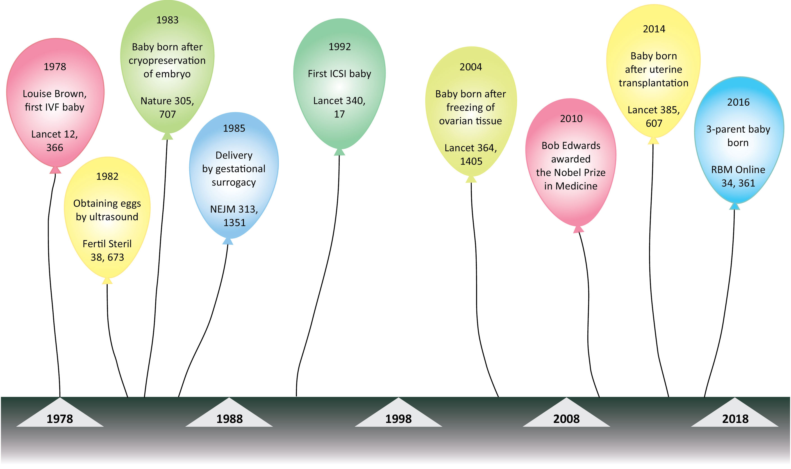
Modern advancements to IVF
Some of the recent advancements in IVF include cryopreservation of surplus embryos.
There is the introduction of intracytoplasmic sperm injection which helps in treating male infertility.
There is also chromosomal screening by the preimplantation genetic diagnosis, mitochondrial donation is also evident in modern advancements in IVF .
Other advancements include cryopreservation of the ovarian tissue, uterine transplantation and other modifications in the treatment of infertility.
The diagram aside presents recent developments In IVF.

Slide 6
Canadian guidelines for doctors and patients undergoing IVF in present times
Some of the Canadian guidelines concerning patients and doctors undergoing IVF in recent times include an initiative of a step-wise progression in treatment which is least invasive, least expensive option
It is followed by a gradual progression to therapies using assisted reproductive technology.
These guideline try's to provide a comprehensive, evidence based recommendations for the treatment of unexplained infertility which include expectant management, laparoscopy, intrauterine insemination, ovarian stimulation and IVF.

Slide 7
Societal impacts and viewpoints of IVF?
Some of the societal viewpoints of IVF is that it is seen as having changed what was once the private province of two people joined in a socially approved union .
This is because IVF involves the deliberate separation of reproduction from the act of human sexuality and from the human body .
Another ethical issue is about how the technology is applied and where it is leading to.
Another ethical consideration is about our obligation as a society to the gametes and the early embryos .
Basic research on IVF need to be done in order to increase physician understanding of the fundamentals of reproduction, the causes of premature labor and more effective birth controls.

Slide 8
References
Huang, J. Y. J., & Rosenwaks, Z. (2012). In vitro fertilizations treatment and factors affecting success. Best practice & research Clinical obstetrics & gynecology, 26(6), 777-788.
Jennings, J. C., Moreland, K., & Peterson, C. M. (1996). In vitro fertilization. Drugs, 52(3), 313-343.
Pandian, Z., Gibreel, A., & Bhattacharya, S. (2015). In vitro fertilization for unexplained subfertility. Cochrane Database of Systematic Reviews, (11).

